Slide 1



Hardware and Software Fundamentals of Intelligent Computing Systems

Slide 2
Lecture 13: Convolution Operator Optimization

Slide 3
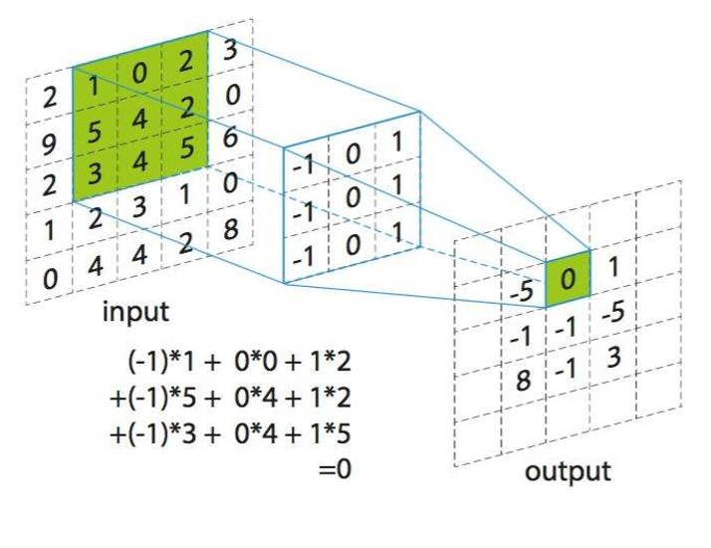
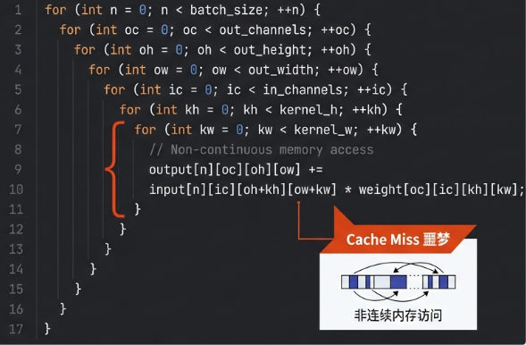

Basics of 2D convolution operators
Principles
Inputs: input feature maps, weight matrix, bias (optional)
Outputs: output feature maps
Core operations: Multiply-Accumulation (MAC)
Native Implementation
7-level Loop

Slide 4
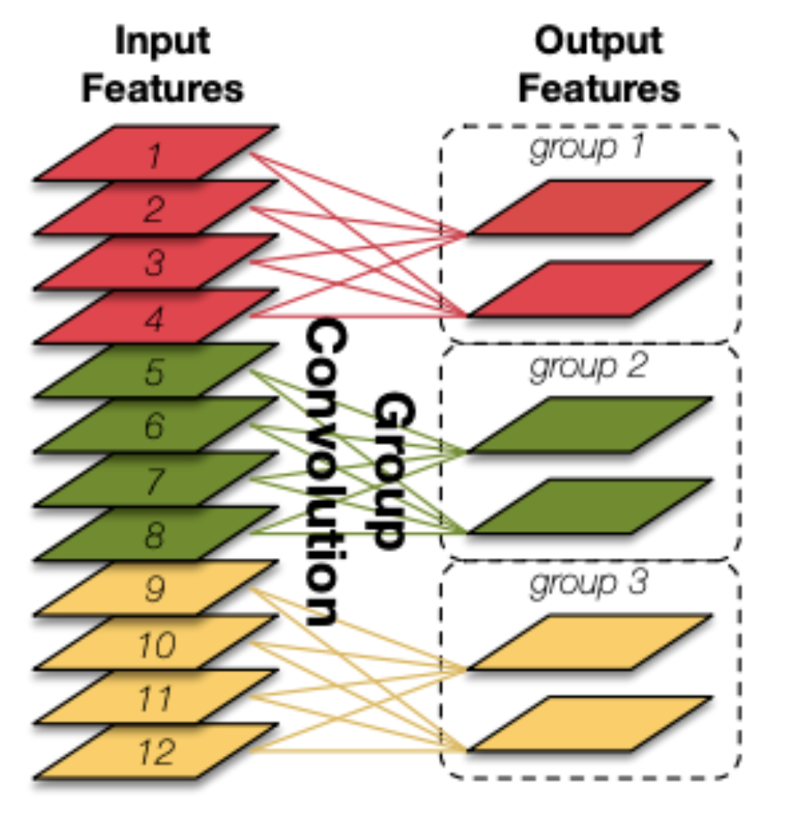
Some variants…
Transposed Convolution
Dilated Convolution
Group Convolution

Slide 5
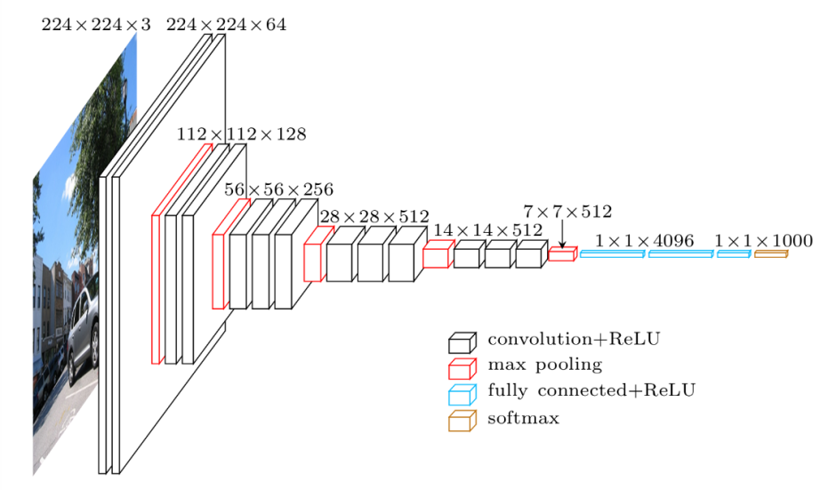
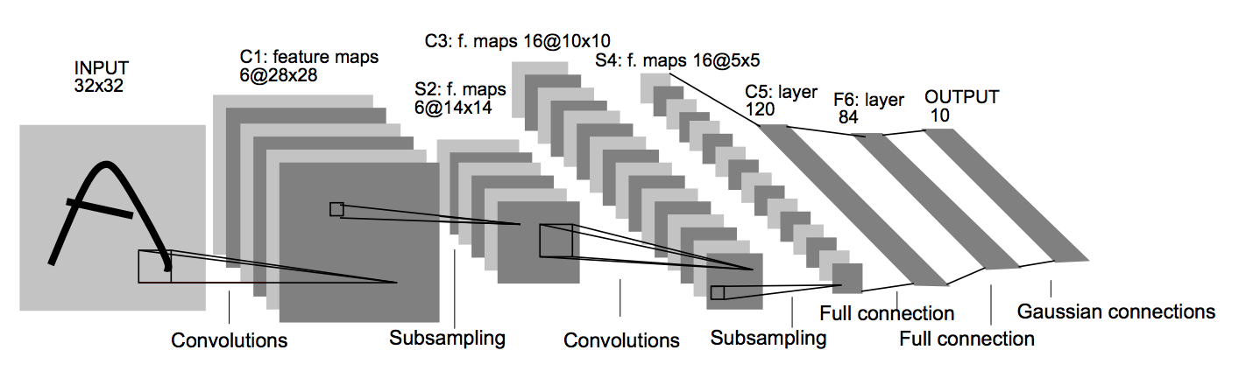
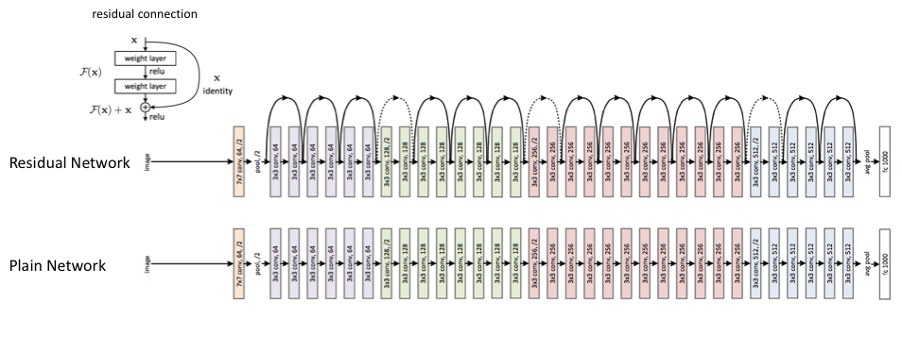
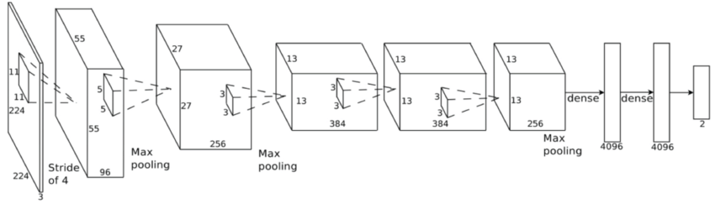
CNNs with stacked convolution layers.
Lenet-5
VGG
ResNet
AlexNet

Slide 6
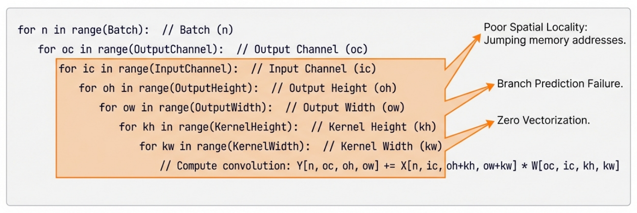
The inefficiency of the naive 7-layer loop
Take the conventional convolution operator as an example.
Mathematically correct. Structurally disastrous.
FLOPs = 2 * OutChannel * InChannel * OutHeight * OutWidth * KernelHeight * KernelWidth

Slide 7
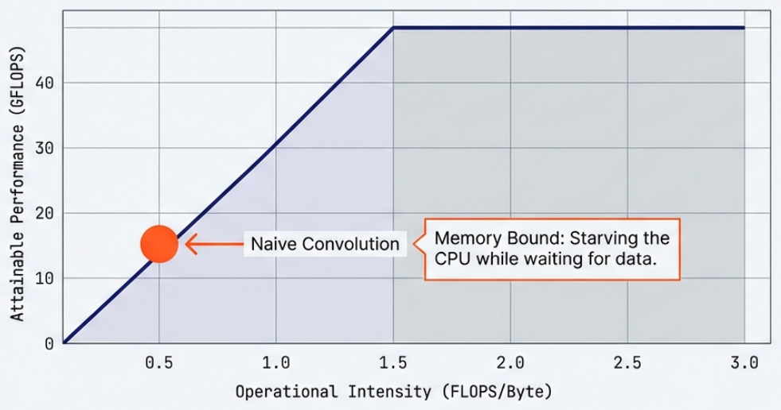
Performance analysis tool: roofline model
Computing power vs. Memory bandwidth

Slide 8
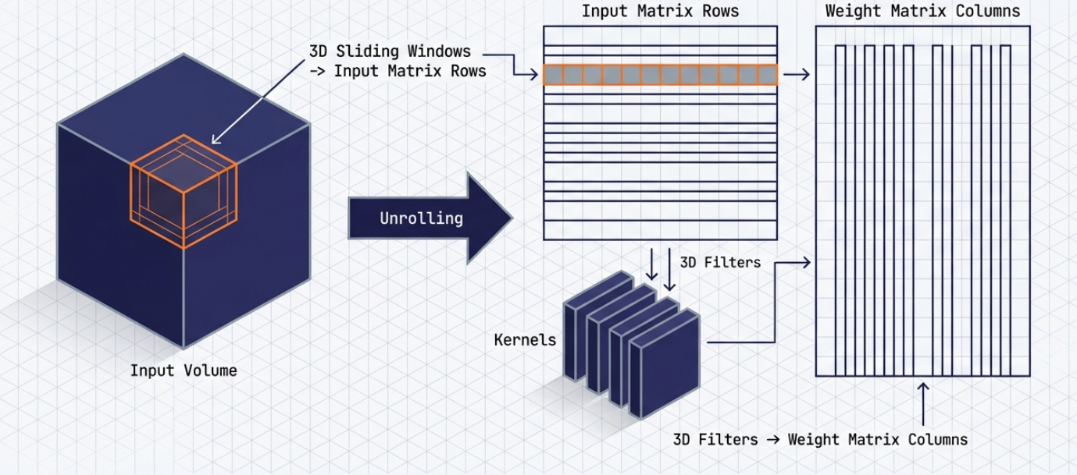
Img2Col transformation
Converting geometry to arithmetic
Problem transformed from spatial convolution to general matrix multiply (GEMM).

Slide 9
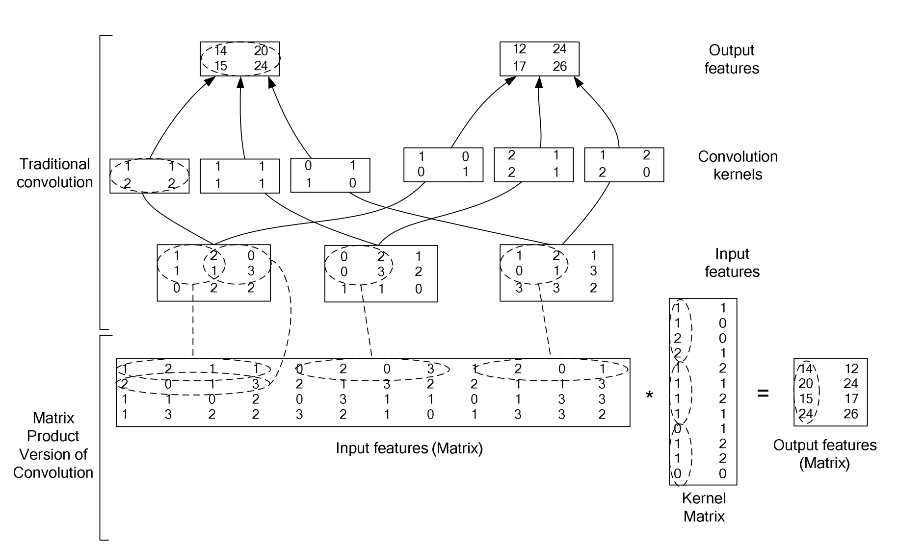
Img2Col transformation
Comparisons between the conventional conv. and the img2col conv.
How to construct the input features and the kernel matrices?

Slide 10
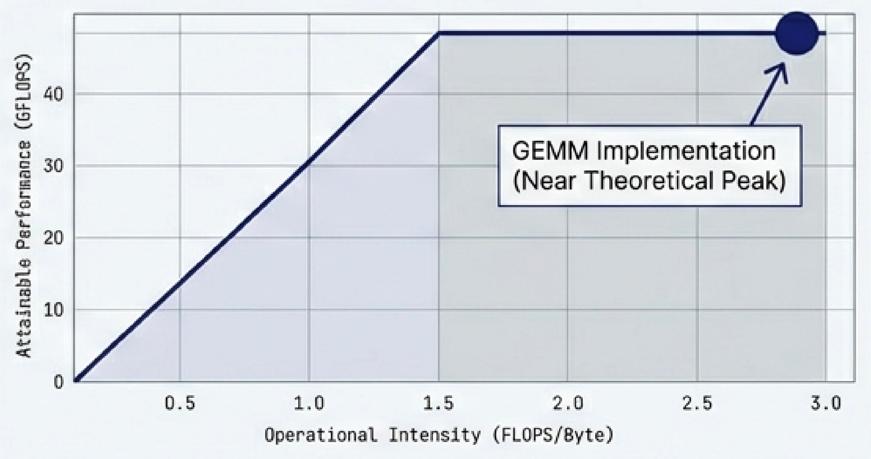
Img2Col transformation
Leveraging the power of GEMM and BLAS libraries from the vendors.
Intel MKL, NVIDIA cuBLAS, Ascend catlass, etc.
GEMM is usually highly-optimized with (1) micro-kernel opt.;
(2) memory packing and layout ordering; and (3) cache blocking.

Slide 11
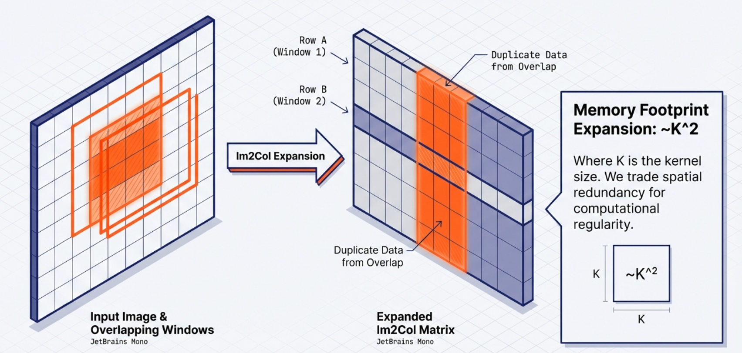
Img2Col transformation
The memory penalty of Img2Col transformation.

Slide 12
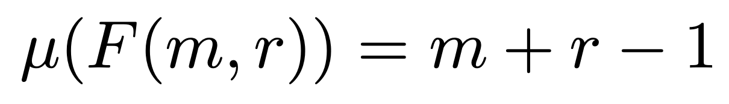
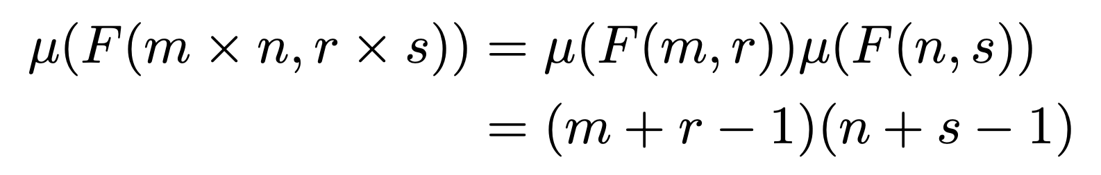
Winograd convolution
Basics: computing m outputs with an r-tap FIR filter, which we call F(m, r), requires the numbers of multiplications as:
In the 2D convolution operators, computing m × n outputs with an r × s filter, which we call F(m × n, r × s). These require the numbers of multiplications as:
[1] https://epubs.siam.org/doi/abs/10.1137/0209021
[2] https://arxiv.org/pdf/1509.09308

Slide 13
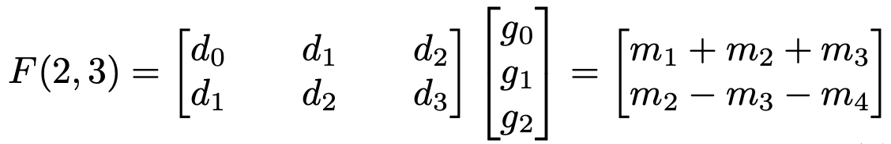
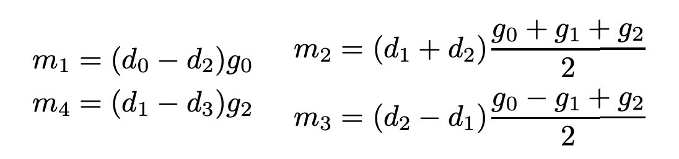
Winograd convolution
Consider a 1D convolution, F(2, 3), it uses 2×3 = 6 multiplications in the conventional algorithm. Winograd rewrites the results using m1 -- m4:
Therefore, it only needs 4 multiplications, 11 additions, and 2 right arithmetic shifts.
g1+g2 can be reused.
[1] https://epubs.siam.org/doi/abs/10.1137/0209021
[2] https://arxiv.org/pdf/1509.09308

Slide 14
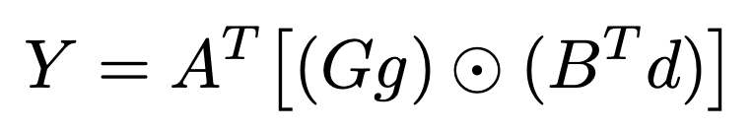
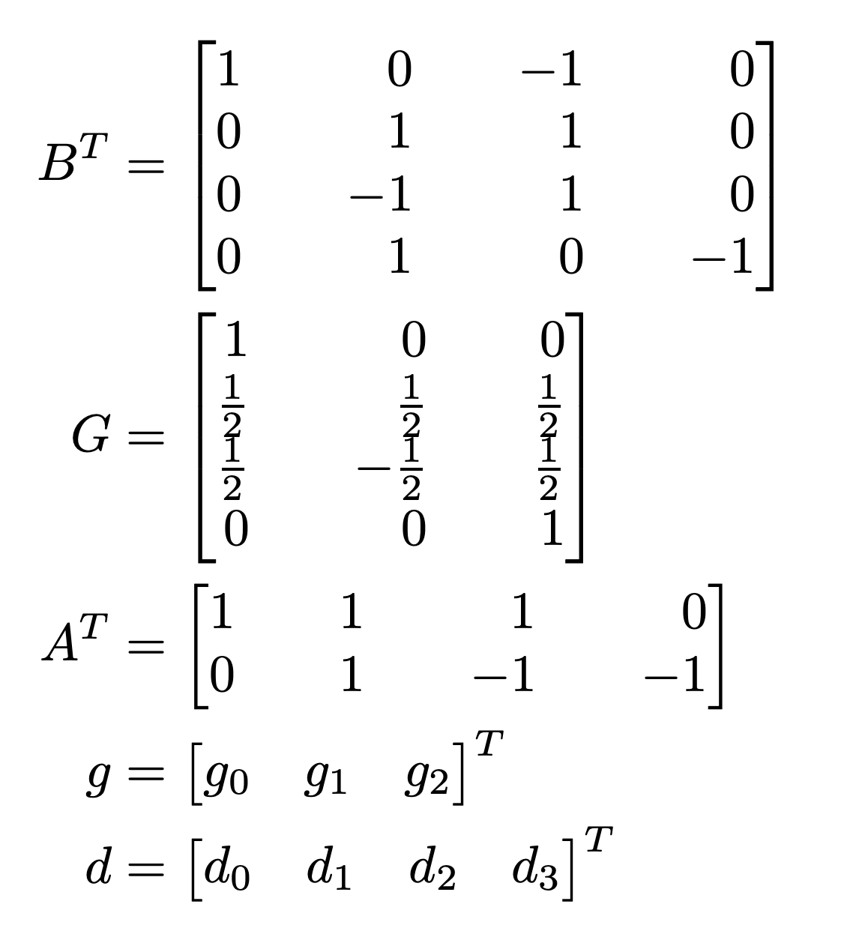
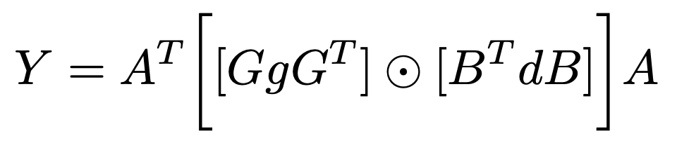
Winograd convolution
Therefore, this fast filtering algorithm can be written in matrix form as:
The 2D convolution can be written as:
[1] https://epubs.siam.org/doi/abs/10.1137/0209021
[2] https://arxiv.org/pdf/1509.09308

Slide 15
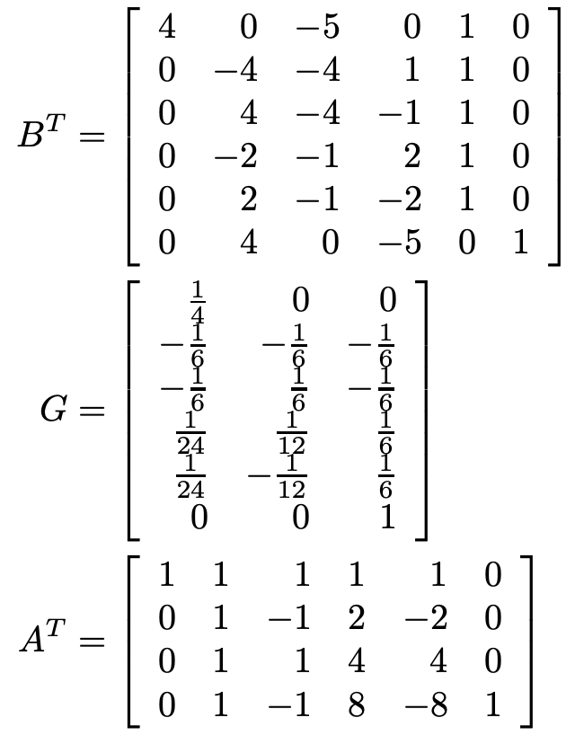
Winograd convolution
F(2 × 2, 3 × 3) is efficient, how about the F(4 × 4, 3 × 3)?
It can reduce 6.00x multiplications in theoretical. But the transformation matrix is much more complex.
The complexity of the transforms will overwhelm any savings in the number of multiplications.
The magnitude of the transform matrix elements also increases with increasing tile size.
[1] https://arxiv.org/pdf/1509.09308

Slide 16
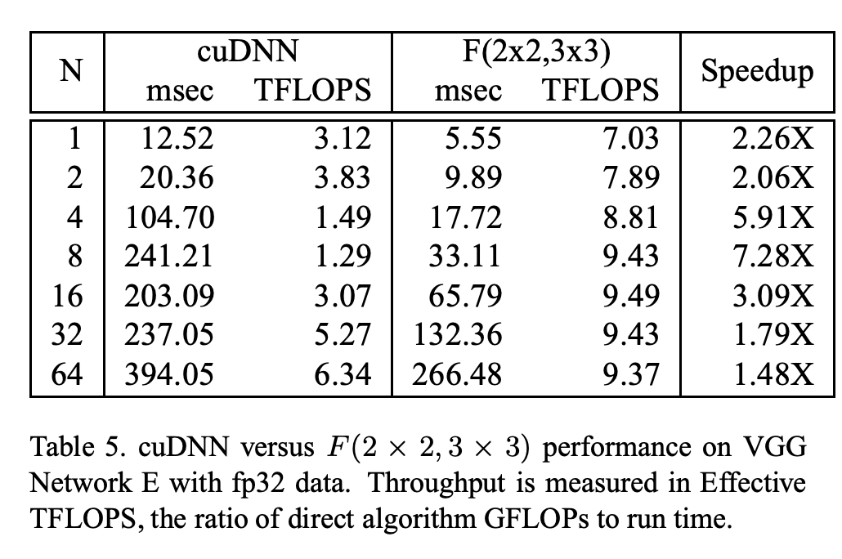
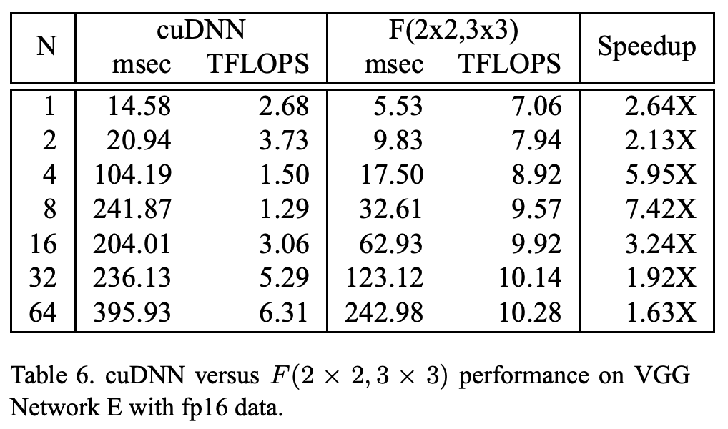
Winograd convolution
Performance comparisons
[1] https://arxiv.org/pdf/1509.09308

Slide 17
Summary
Comparisons among direct convolution, img2col + GEMM, and Winograd.
Feature | Direct Convolution | Img2col + GEMM | Winograd F(2x2, 3x3)
Computational Complexity | High (O(N)) | Medium (Optimized via GEMM) | Low (Fewest multiplications)
Memory Overhead | Minimal | Large (Data redundancy) | Medium (Requires transform matrices)
Implementation Difficulty | Simple | Moderate | Complex
Numerical Precision | Highest | High | Lower (Floating-point error accumulation)
Core Limitations | Slow performance | High memory consumption | Restricted to Stride=1 & 3x3 kernels
[1] https://arxiv.org/pdf/1509.09308

Slide 18

The Solution: FlagOS, a Unified AI Software Stack

Slide 19








https://space.bilibili.com/3546791834290849
https://github.com/flagos-ai
https://www.zhihu.com/people/95-22-20-18/posts
https://flagos.io/Home

Slide 20

Thanks for your time！

